Slide 1
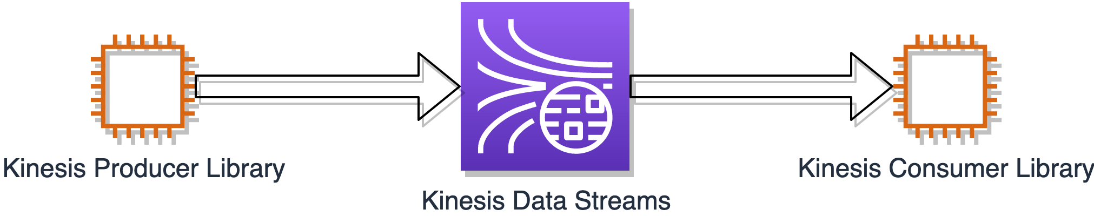

AWS Machine Learning - Data Engineering
Fault Tolerance and Persistence
Fault tolerance and persistence
Kinesis Data Streams data collection

Slide 2
AWS Machine Learning - Data Engineering
Fault Tolerance and Persistence - Kinesis Producer Library
Fault tolerance and persistence
Kinesis Data Streams data collection
KPL can send multiple records per write to the stream
Has buffer for retries
If one record fails, the other records in the multiple-record set are still processed

Slide 3
AWS Machine Learning - Data Engineering
Fault Tolerance and Persistence - Kinesis Data Streams
Fault tolerance and persistence
Kinesis Data Streams data collection
Synchronous replication - 3 AZs
Data retained for up to 24 hours - can extend to 7 days

Slide 4
AWS Machine Learning - Data Engineering
Fault Tolerance and Persistence - Kinesis Consumer Library
Fault tolerance and persistence
Kinesis Data Streams data collection
Processes the data from the data stream
Checkpointing using DynamoDB to keep track of records that have been read from the Kinesis Stream shard.
If KCL worker fails, a new KCL can resume using the checkpoint
Key Points
DynamoDb tables created for you for checkpointing are named using the KCL name
May experience DynamoDB provisioned throughput exceptions if too many shards or frequent checkpointing

Slide 5
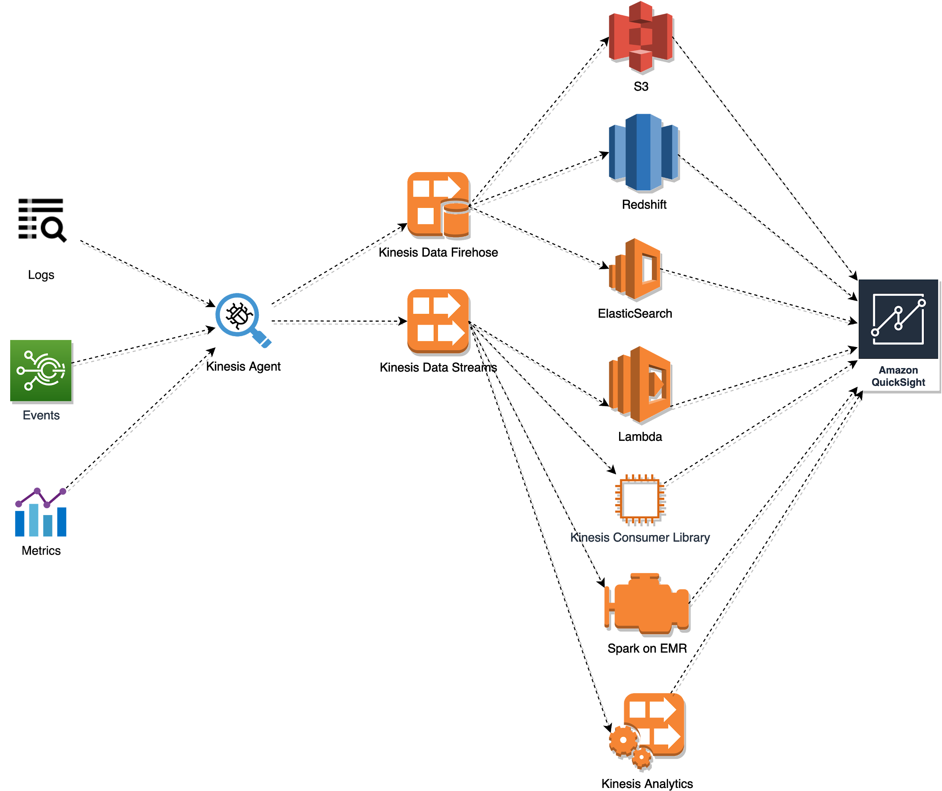
AWS Machine Learning - Data Engineering
Fault Tolerance and Persistence - Kinesis Producer Alternatives
Two alternative to produce your streaming data
Kinesis Agent

Slide 6
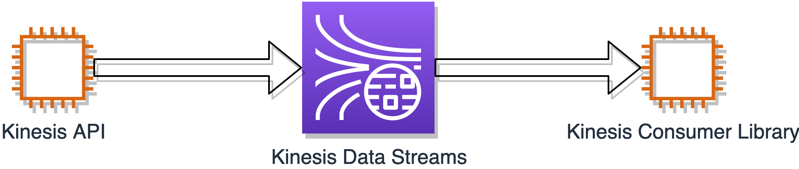
AWS Machine Learning - Data Engineering
Fault Tolerance and Persistence - Kinesis Producer Alternatives
Two alternative to produce your streaming data
Kinesis API
Use when you need fastest processing time
Avoid RecordMaxBufferedTime of the KPL

